Slide 1

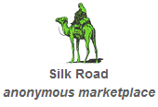
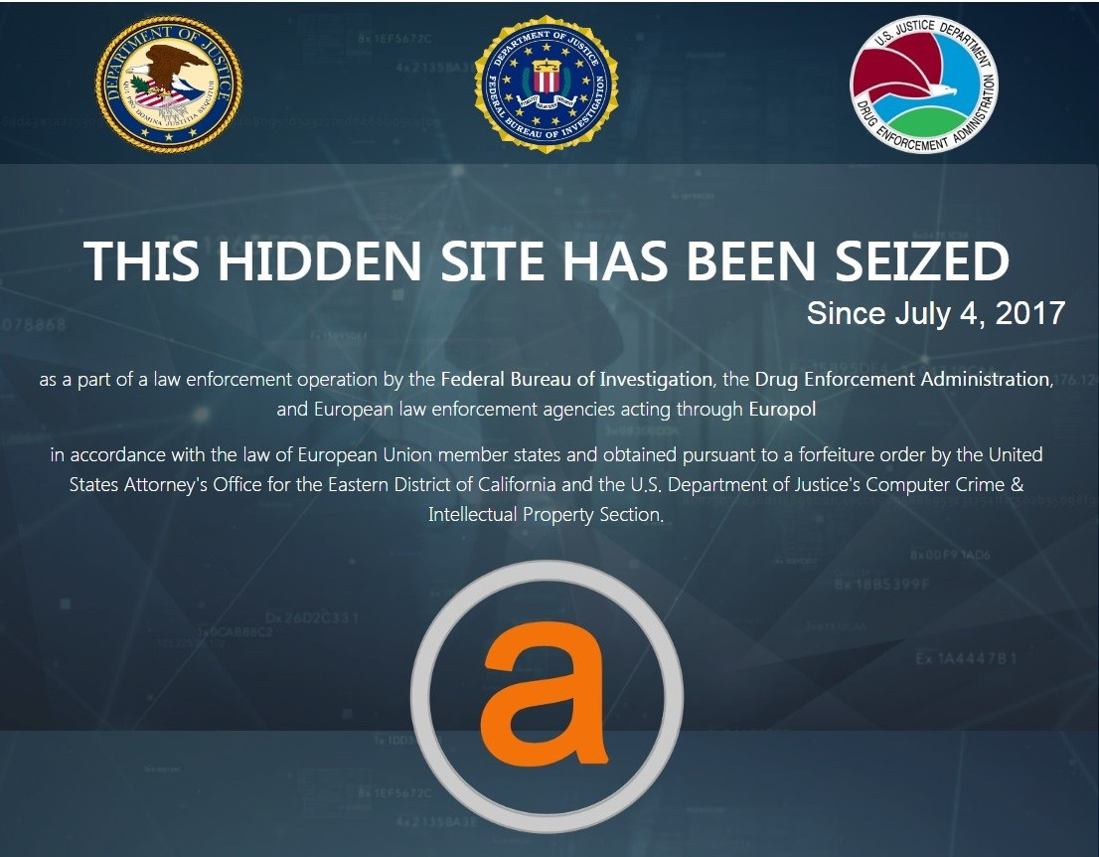




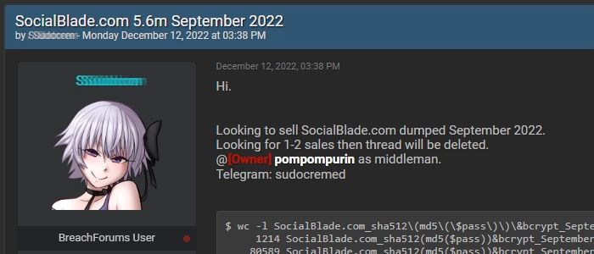


Slide 2

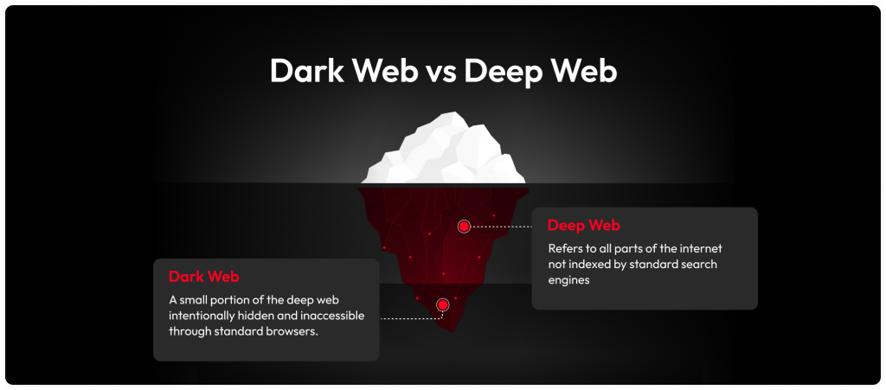



Slide 3
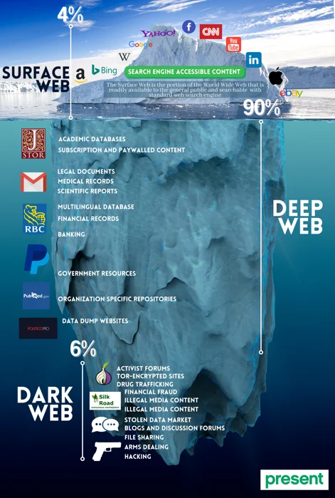


I love a good
+ so much more!!

Slide 4
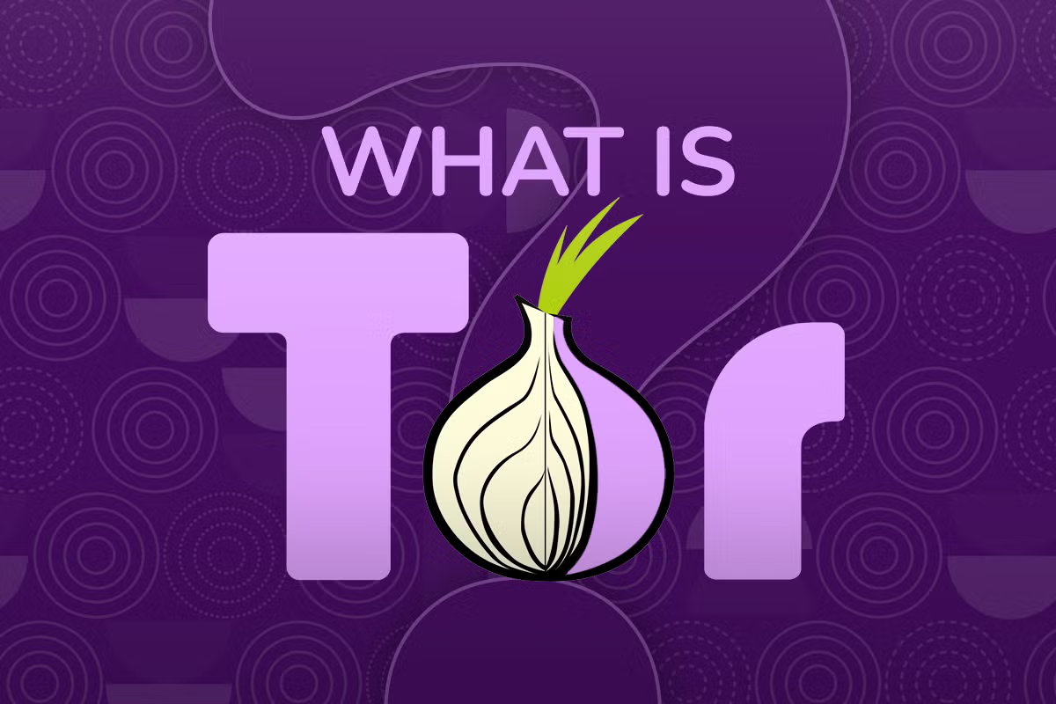
TF IS IT ABOUT ONIONS??

Slide 5

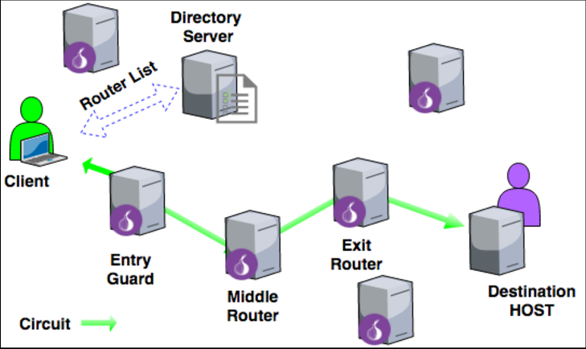
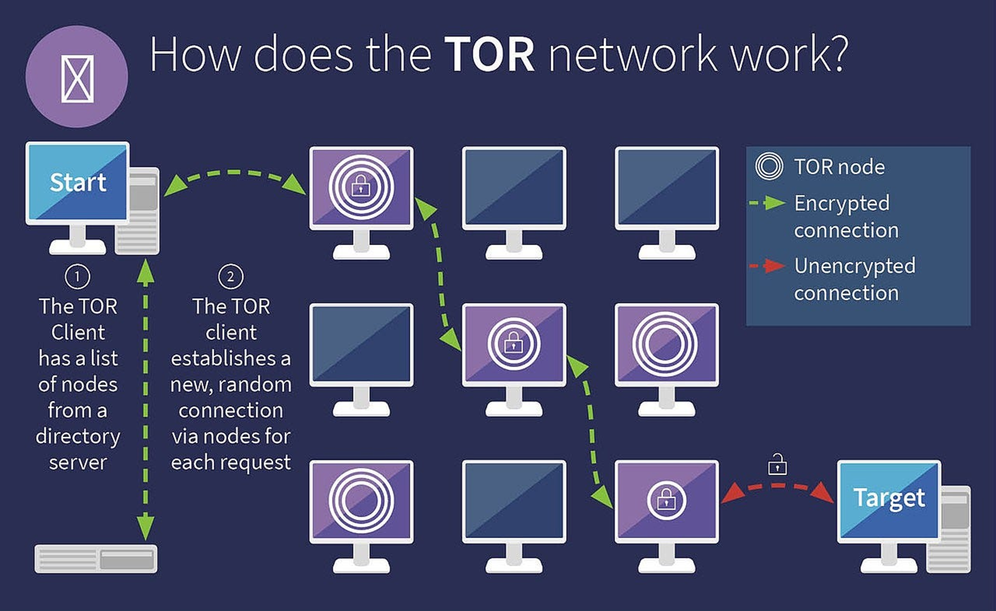


Onion Routing

Slide 6
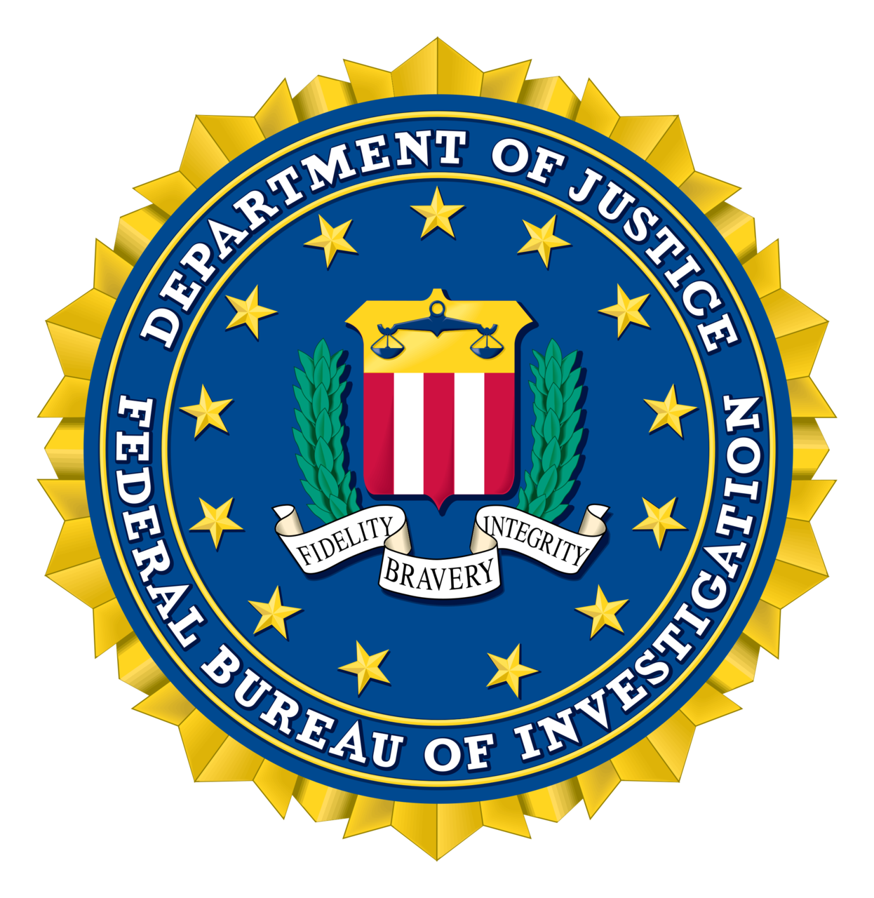


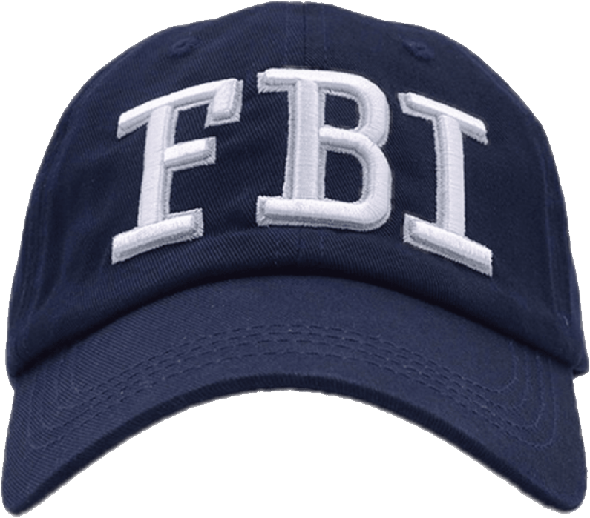
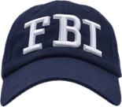

It’s not FULLY secure (apparently)
FULL OF OPS

Slide 7

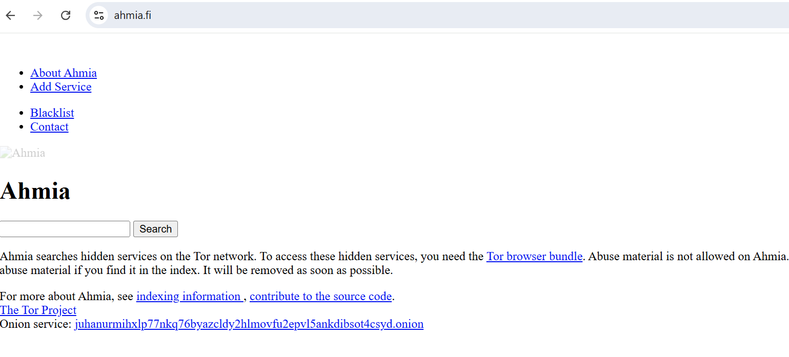
TF IS
Ahmia is a versatile search engine that works with both surface web and dark web sites. The company aims to make dark web browsing safer by curating search results to exclude fake or harmful sites, including those harboring malware. Ahmia allows you to search for . onion URLs through their websites on the surface web
???

Slide 8

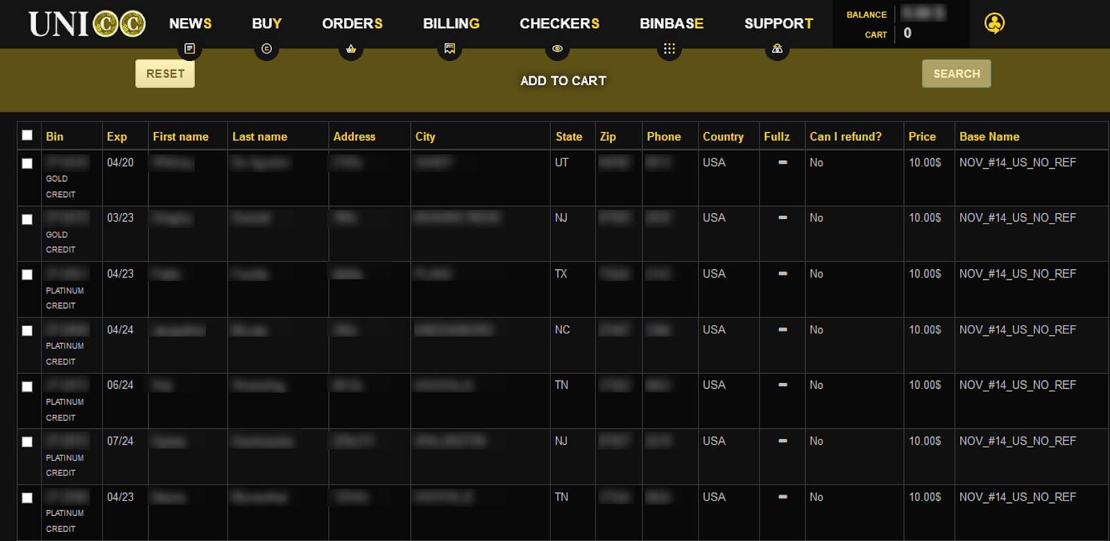
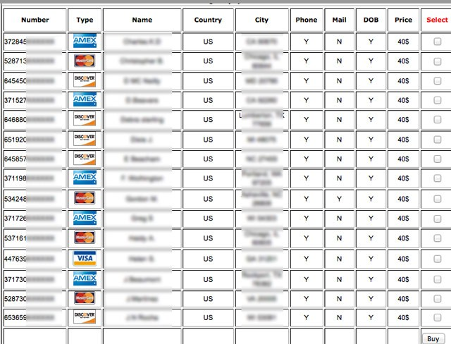

How Hackers Make BANK
The most common way hackers monetize ransomware data is by selling stolen information on the dark web.

Slide 9

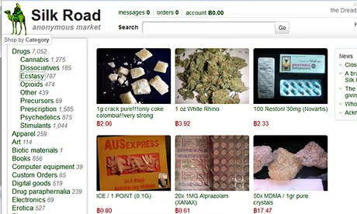
The Silk Road does not currently exist. Its immediate successor, Silk Road 2.0, which was operated by administrators of the original site, ceased to exist on November 6, 2014, after being shut down by an international police task force. Silk Road is not active today and hasn’t been used since Silk Road 2.0 shut down.
The Better

Slide 10
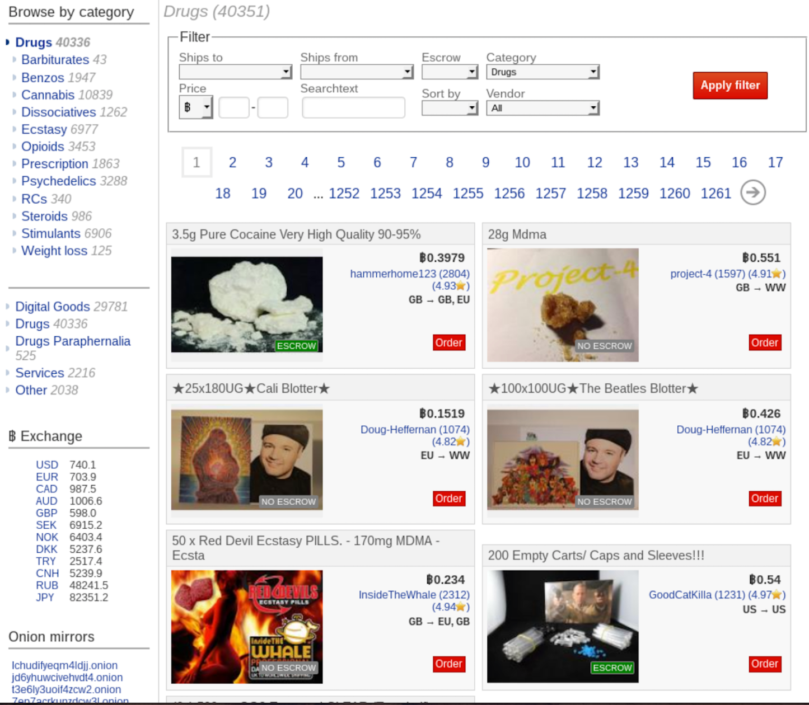

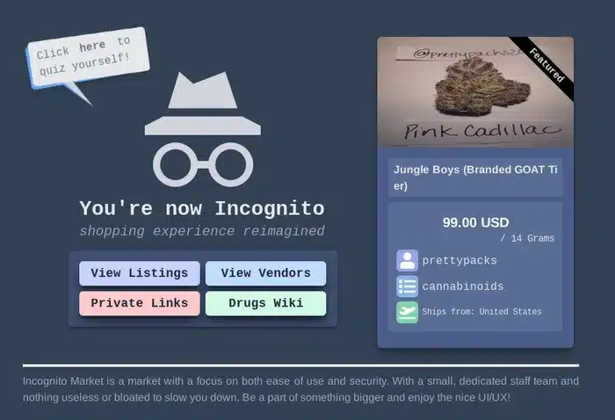
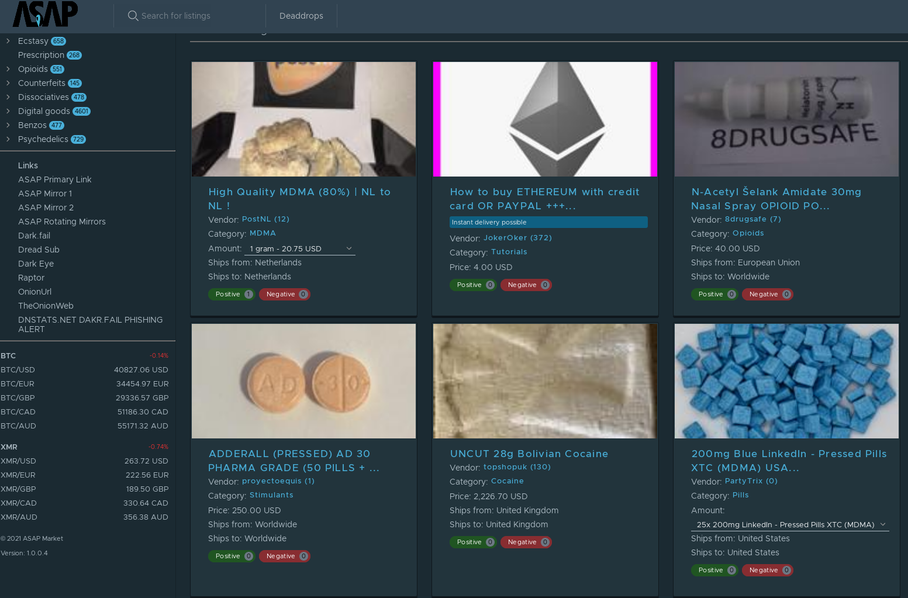
What Replaced The Silk Road??
Agora, AlphaBay, Dream Market, and Hydra replaced Silk Road and Silk Road 2.0, although all are now defunct.
Some current darknet marketplaces include ASAP market, Archetyp, and Incognito, but many former dark web marketplaces have gone mobile on encrypted secure messaging apps like Telegram.

Slide 11



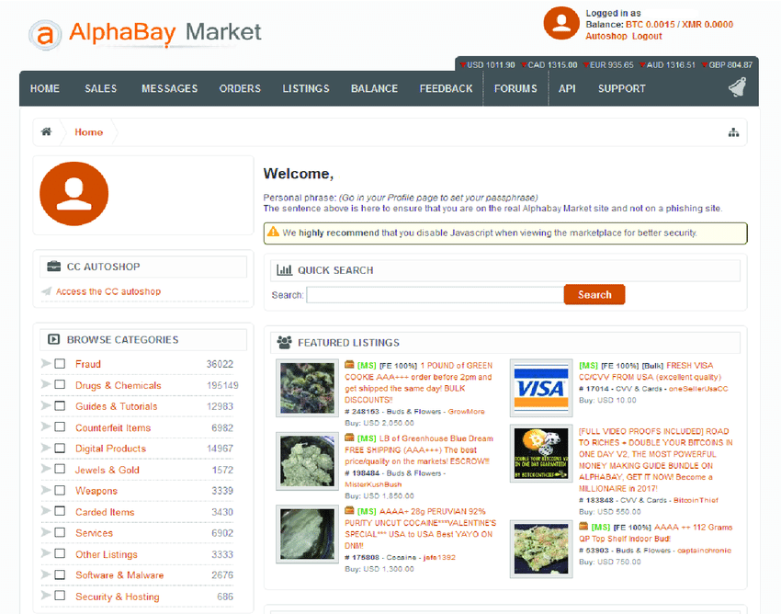
AlphaBay accessed through the TOR network, had over 40,000 vendors at its peak, and over 250,000 listings of drugs and other chemicals, as well as over 100,000 listings for stolen identities, credit cards, counterfeit goods, malwares, and firearms, among others. Estimates suggest this marketplace facilitated trades worth USD 1 billion in bitcoin and other cryptocurrencies.

Slide 12


Once Again, WHAT TF HAPPENED??
In 2017, a coordinated effort, codenamed “Operation Bayonet” by the Dutch National Police, Europol, and the FBI, shut down the two dark web markets which together traded over 350,000 illicit commodities, ranging from opioids, ransomwares and money laundering. It became known as one of the most sophisticated takedown operations against cybercrime.
This was a undercover Europol mission, with shared intel between the Dutch national police, and later with the American authorities. While the American and the Thai authorities worked together to shut down AlphaBay, Europol and the Dutch police had secretly infiltrated and taken control over Hansa’s infrastructure. This essentially led to the creation of a honeypot in the aftermath of the AlphaBay shut down.

Slide 13

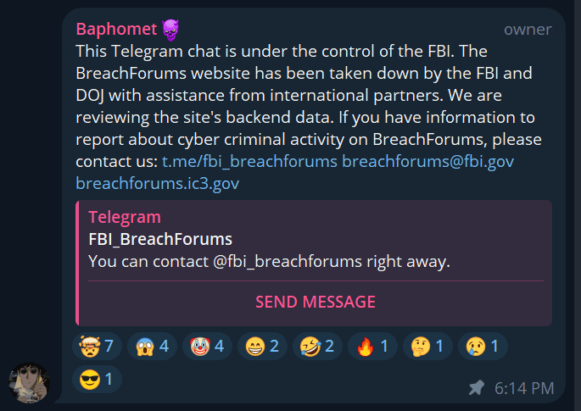
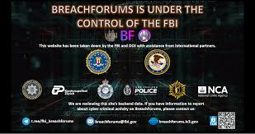

BreachForums <3
BreachForums, sometimes referred to as Breached, is an English-language black hat–hacking crime forum. The website acted as an alternative and successor to RaidForums following its shutdown and seizure in 2022.

